Slide 1


NEURAL NETWORKS PRESENTATION BY : ADITHYA KIRAN PES1201700231
CNN
LSTM
RNN

Slide 2
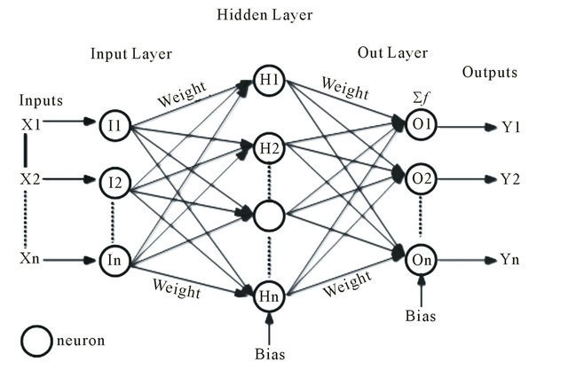
Neural networks
The models we build are made of neurons called perceptrons.
The idea is to imitate the human brain and create a network of neurons that are capable of learning a desired topic based on a given set of data without us having interfere in the learning process.
They mainly work on the concept of feeding data forward and the propagating backwards to correct the biases to obtain the correct output.
Neural networks are made of input layer, hidden layers of neurons and the output layer.

Slide 3
We use keras as the front end with tensorflow as backend to create our model. They are libraries that provide a large number of useful functions and datasets for machine learning.
The main types of MLP networks that we learnt were:
CNNs - Convolutional Neural Network
RNNs - Recurrent Neural Network
Apart from the input ,hidden and output layers we must also add the activation functions (RelU ,tanH ,sigmoid ,etc) and other functions to calculate loss and accuracy.
Overfitting and underfitting data:
We can prevent this by adding functions such as dropout and use of batch normalization.

Slide 4
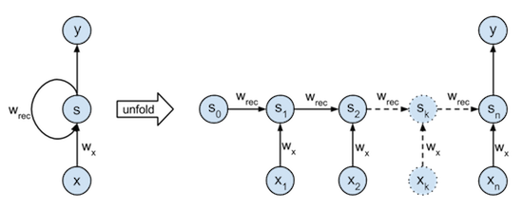
Recurrent Neural Network
In recurrent neural network (RNN), connections between units form a directed cycle (they propagate data forward, but also backwards, from later processing stages to earlier stages). This allows it to exhibit dynamic temporal behaviour.
This makes them applicable to tasks such as speech recognition and other general sequence processors.

Slide 5
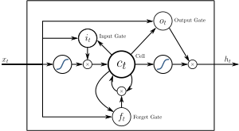
LSTM - long short term memory
LSTMs are one of the fundamental units of RNNs.
A RNN made mainly of LSTM is also called LSTM network
It refers to a short term memory that lasts as long as possible
Its main feature is the forget
gate which allows it to store
errors from previous runs

Slide 6
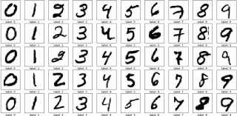
As part of my final assignment for this course I chose to create a CNN to classify handwritten digit based on the MNIST dataset.
It has 60,000 images to train our network and another 10,000 images to test how our network works.
Each image is 28 pixels x 28 pixels.
Keras provides us this dataset directly.it can also be obtained from the official website: http://yann.lecu.com/exdb/mnist/

Slide 7
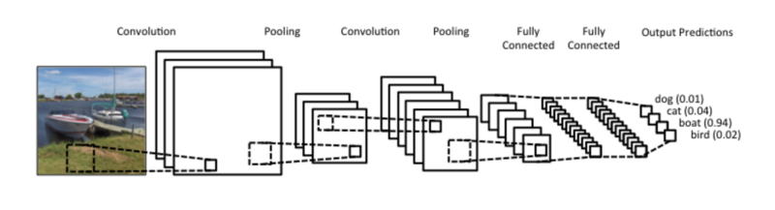
Convolutional Neural Network
These are one of the most used networks for image classification.
They consist of input layer, dense layer and output layer.
Between the input and dense layer we perform many functions. The main steps of convolution are namely: a) convolution b)pooling and c)activation.

Slide 8
Convolutional Neural Network
The convolution function applies filters across a specified dimension of pixels and iterates throughout the entire image. This helps in learning in greater detail about the image.
The pooling layer is used to down-sample the input to enable the model to make assumptions about the features so as to reduce over-fitting. It also reduces the number of parameters to learn, reducing the training time.
The activation function is used to decide which neuron gets activated. I have used RelU. It sets all negative values in the matrix ‘x’ to 0 and keeps all the other values constant
We apply multiple convolution layers to better train the network.
Once this is done, then comes the dense/fully connected layer which consists of the neurons and performs the function of classification based on what the network has learnt.
These networks are mainly used in image classification.

Slide 9
THANK YOU

